Slide 1
Defect Life cycle in Software Testing​

Slide 2
What is Defect Life Cycle?
Defect Life Cycle:
Known as Bug Life cycle is the journey of a defect
Defect goes through during its lifetime

Slide 3
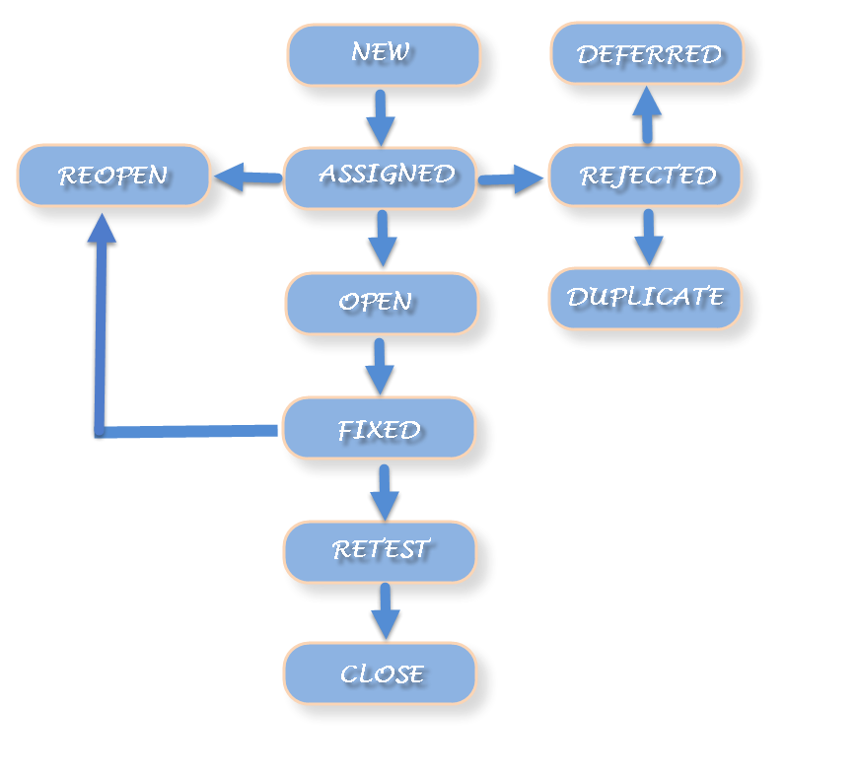
Defect Workflow
Workflow:

Slide 4
Defect States
New:
When any new defect is found, it falls in a ‘New’ state
Defect is logged and posted for the first time

Slide 5
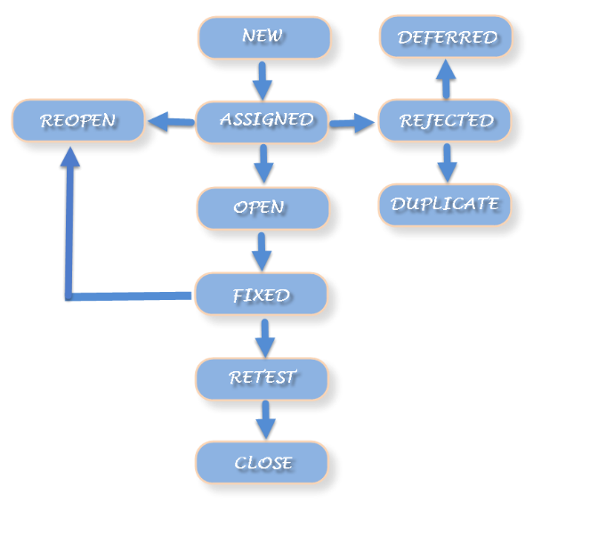
Defect States (Cont…)
Assigned:
Test lead approves the bug and assigns the bug to the developer team.
There can be two scenarios:
- Defect can directly assign to the developer, who owns the functionality of the defect.
- Second, it can also be assigned to the Dev Lead and once it is approved with the Dev Lead, he or she can further move the defect to the developer.

Slide 6
Defect States (Cont…)
Open:
The developer starts the process of analyzing the defect and works on fixing it, if required

Slide 7
Defect States (Cont…)
Fixed:
When the developer finishes the task of fixing a defect by making the required changes then he can mark the status of the defect as “Fixed”.

Slide 8
Defect States (Cont…)
Retest:
The tester starts the task of retesting the defect to verify if the defect is fixed accurately by the developer as per the requirements or not.

Slide 9
Defect States (Cont…)
Re-Open:
If the bug still exists even after the bug is fixed by the developer, the tester changes the status to “reopen”.

Slide 10
Defect States (Cont…)
Rejected:
If the developer feels that the bug is not genuine, developer rejects the bug. Then the state of the bug is changed to “rejected”.

Slide 11
Defect States (Cont…)
Deferred:
The bug is expected to be fixed in next releases
Reasons:
Priority of the bug may be low
Lack of time for the release
Bug may not have major effect on the software.

Slide 12
Defect States (Cont…)
Duplicated:
The developer finds the defect as same as any other defect
if the concept of the defect matches any other defect

Slide 13
Defect States (Cont…)
Closed:
When the defect does not exist any longer, then the tester changes the status of the defect to “Closed”.

Slide 14
Thank You

